Slide 1







การประยุกต์ระบบ IOT เพิ่มผลิตภาพการผลิต ด้วยโปรแกรม Arduino & I.O.T. September 7th 2021

Slide 2

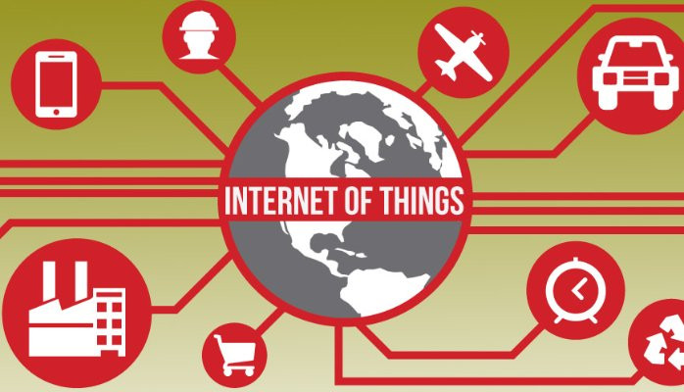
หัวข้อการบรรยาย
1
วันที่ 1
Session 1
2
วันที่ 1 Session 2
และ
วันที่ 2 Session 3
เทคนิคการเพิ่มผลิตภาพการผลิตด้วยระบบ IOT
การเขียนโปรแกรมภาษา C เบื้องต้น
การใช้โปรแกรมเสมือนจริง Tinkercad
การประยุกต์ใช้ Tinkercad ในการออกแบบ วงจร IOT
Workshop การทดลองผ่าน Tinkercad

Slide 3
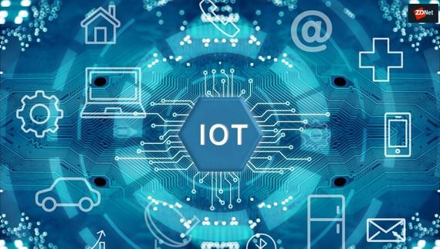
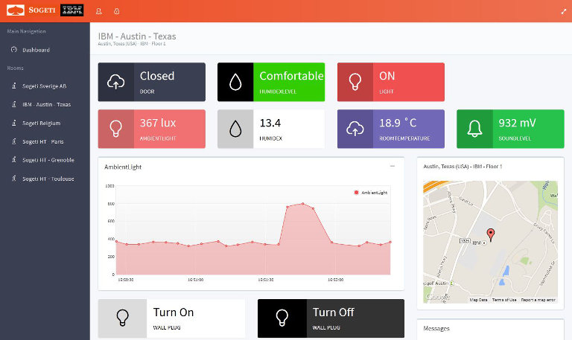
Slide 3
3
เข้าสู่โลก Internet ด้วยอุปกรณ์ ESP
อุปกรณ์ ตระกูล ESP
ESP8266
ESP32
การออกแบบวงจร IOT & WiFi
การทดลองสั่งงานด้วย ผ่าน Application
การเก็บภาพเข้าฐานข้อมูล
การเชื่อมต่อ/สั่งงานด้วย MQTT
การเชื่อมต่อกับฐานข้อมูล
วันที่ 2
Session 4
4
การสร้าง Dashboard
สร้างด้วยโปรแกรม HTML + Php
สร้างด้วยโปรแกรม Grafana
การใช้งาน Grafana
การสร้างสัญญาณเตือนด้วย Grafana
การสร้าง Dashboard ด้วย Power BI
วันที่ 3
Session 5

Slide 4







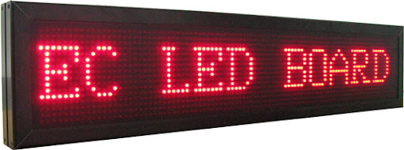

ผู้บรรยาย
ดร. พสิษฐ์ ธนาโชติอนันต์กุล
Lineid: pasidthred
Email: pasidthdr@gmail.com
Wechat: +66873433043
Github: https://github.com/DrPasidth?tab=repositories
ป.ตรี วศ.บ พระจอมเกล้าธนบุรี
ป.โท การตลาด นิด้า
ป.เอก การจัดการ ปัญญาศัตรา
ทีมงาน
อจ. อัษฎง ภูวรักษ์ (วท.บ)
ร้อกเวิลธ์เฟอร์นิเจอร์(อินเดีย)
สามารถเทเลคอม(มาเลย์เซีย)
เทเลคอม(กัมพูชา)
เจนบรรเจิด
สหวิริยาเทเลคอม
ฟิลิปส์อิเลคทรอนิคส์(ปทท)
ผู้ประดิษฐ์ป้ายไฟ LED ภาษาไทย คนแรก
วิศวกรโครงการโรงไฟฟ้าแม่เมาะ 4 - 7

Slide 5
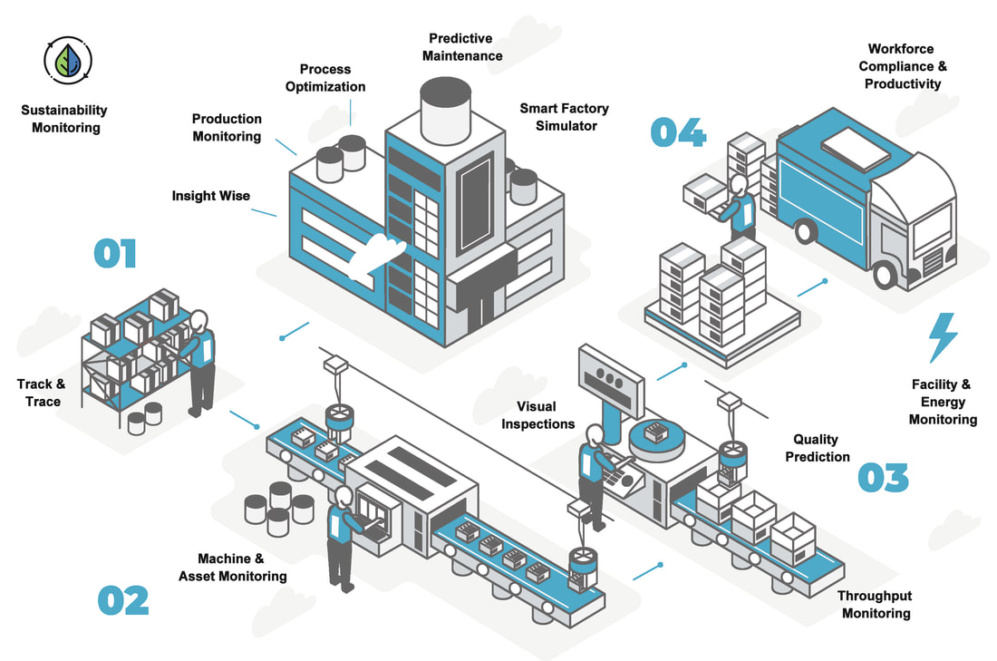

Slide 6
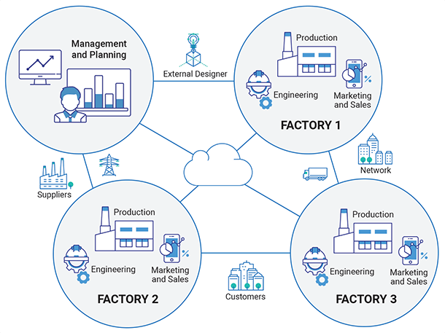

Slide 7
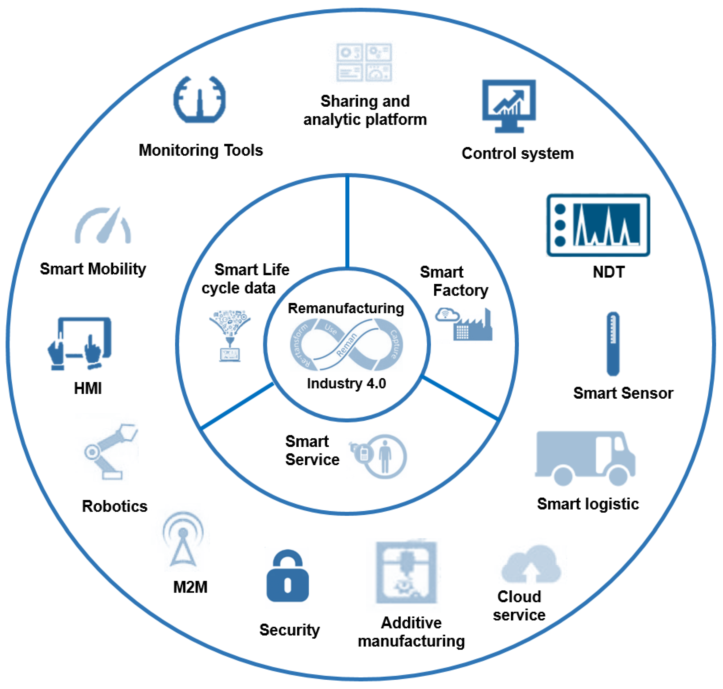

Slide 8
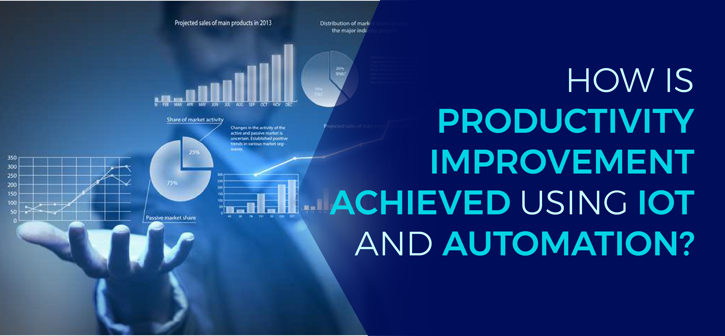

Slide 9


Slide 10
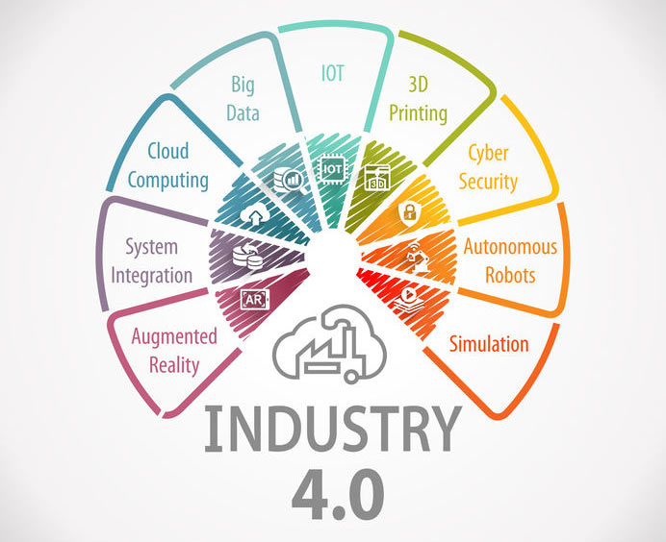

Slide 11
IoT and Better Manufacturing
Notes:
When conducting research, it is easy to go to one source: Wikipedia. However, you need to include a variety of sources in your research. Consider the following sources:
Who can I interview to get more information on the topic?
Is the topic current and will it be relevant to my audience?
What articles, blogs, and magazines may have something related to my topic?
Is there a YouTube video on the topic? If so, what is it about?
What images can I find related to the topic?

Slide 12
Companies are now enabled to monitor like never before.
By obtaining and analyzing data at different points in the complex product processes.
They are looking to understand better where the process takes a lag and thereby becomes less productive.
The production lines can be kept on the roll more efficiently by ensuring that the line is monitored and fed optimally to keep the flow or throughput at its best.
It can be ensured that the raw materials needed are made available and planning can be far more feasible since the variables in the process are going to get reduced.
Monitoring
Analyzing
Understanding
Throughput
Availability

Slide 13
Asset Management
Trackability
Right Places at Right Time
Warning System
The floor managers now would be able to keep track on the different assets.
Thus there will be less time lost in looking for things are they are all trackable.
There is more security of the important assets and systems that can ensure that things are not left out in the wrong places.
Ability to guide workers to the right destinations and ability to provide warnings to the users in case there is any hazardous situations.

Slide 14
Reduce Inventory Costs
Reduce Operational Costs
Reducing Wear & Tear
Increase capacity
Aspects like better Inventory management, better and optimal procurement, lesser cost of carry would fall in place.
Increased reduction of operational costs slowly and steadily would give additional leverage.
With increased efficiency and transparency in the manufacturing processes, the predictability would stand to increase and the ability to provide a better ETA to customers
Becomes more of the statistical affair than that of a heroic effort by the team thereby reducing the wear and tear of the men as well as the machines.
This obviously would also mean increased capacity and hence more output when needed.

Slide 15
IoT and Better Sales
Notes:
After consulting a variety of sources, you will need to narrow your topic. For example, the topic of internet safety is huge, but you could narrow that topic to include internet safety in regards to social media apps that teenagers are using heavily. A topic like that is more specific and will be relevant to your peers. Some questions to think about to help you narrow your topic:
What topics of the research interest me the most?
What topics of the research will interest my audience the most?
What topics will the audience find more engaging? Shocking? Inspiring?

Slide 16
Improve Order Fulfillment
Reduce Lead Times
Better Engagement
Increased ability to manage and track inventories especially of products would extend to making order fulfillment much more a smoother process.
The overall process of sales would become faster and transparent. With lesser lead times the satisfaction level of the customer would increase.
It could also lead to better distribution, engagement with the distributors and moving forward and better and deeper connect even to the retailer level by making the use of IoT.

Slide 17
IoT and Better Post Sales
Refer to the notes section below for guidelines on this topic.
Notes:
Now, that you have narrowed your topic, you will want to organize your research in a structure that works. There are some common organizational patterns based on the kind of research you are doing.
Organizational Structures:
Cause and Effect- this kind of structure is great for explaining the causes and effects of a topic
Compare and Contrast- in this pattern you highlight the similarities and differences of the topic
Explain process- this structure is great for outlining a series of steps to follow;
Definition- if you want to make sure your audience understands what something is using illustrations, meanings, clarifying misconceptions, you may want to use this structure
Classification- a common organizational structure is grouping like topics or facts from the research together. For instance, in the internet safety about social media apps, you may organize the research where you look at each social media app one at a time

Slide 18
Increase Product Proliferate
Smart Products
Smart Activities/Connection
Better Spare Parts Preparation
Lesser work in aftersales services
IoT is not just going to be restricted to the making of the product, it is going to proliferate the product too.
Having smart products which can diagnose the problems and tell the customer what needs to be done if it is an easy fix.
Possibly we may even have these products directly registering support calls the moment there is a breakdown so you have a support person connecting as soon as there is the breakdown.
It promises to go to the extent of letting the support know that there is a need for part replacement to prevent a breakdown.
The downside is that Post Sales Support would no longer give a sense of victory after dealing with the customer support that one is gets now!!

Slide 19
IoT All the way
Notes:
After you’ve done your research, it’s time to put your presentation together. The first step in the process is to introduce the topic. This is a great time to connect your topic to something that your audience can relate. In other words, why should they listen to all the information you will be sharing in your research presentation? What is in it for them? You may also want to include a graphic or image to grab their attention.
Feel free to duplicate this slide by right-clicking on this slide in the slides pane to the left and select Duplicate Slide.
The next step in your presentation is to state your claim or topic clearly. Your teacher may even call this your thesis. As you state your thesis, you may find that this layout is not the best layout for your claim or topic. You can change the layout by clicking the drop-down menu next to the Layout in the Slides menu section. You can choose Two Content, Comparison, or Picture with Caption. Note: A different layout might change the look of the icons on this page.
You will also want to state your facts. You have done the research now share some of the interesting facts with your audience. Facts do not have to be boring; you can communicate facts in a variety of ways by going to the Insert Tab. In the Insert tab you can:
Insert pictures from your computer or online.
Add a chart
Create some SmartArt
Insert a variety of icons to help your facts come to life. Note: You can change the color of the icons by selecting the icon and then click on the Format tab and then Graphics Fill. From there, you will choose a color from the list or choose More Fill Colors to give you more options.
Since this research presentation is a result of your hard work and searching, you want to make sure you support the claims or points in your presentation with facts from your research findings. Make sure you give the author proper credit for helping you share your ideas. If one of your sources has a video that is relevant to your topic, you can add the video as added support. Keep in mind the length of the video and the amount of time you have for your presentation. For a 5 minute speech, the video should be no longer than 30 seconds.
Questions to consider:
How will you state the author of the source?
Will you need to cite the source on the slide?
What are some ways you can engage your audience so they feel like they are a part of the presentation? Some ideas to consider is by taking a quick poll like: by a show of hands, how many of you think school uniforms are a way to cut down on bullying? Another suggestion is to have them hold up a certain number of fingers to see if they agree or disagree. Finally, you can share a story that the audience can relate to that makes them laugh.
After all the applause, your audience may have some questions. Be prepared to answer some of their questions by making a list of questions you think they might ask. You may also want to share the presentation with them by providing the link to your presentation, if they want more information.

Slide 20
To the Wave of Productivity
KPI
Improvements
IoT thus would be impacting all the aspects of a product and leaving no room for doubt that it is going to usher in Wave of Productivity.
Move on productivity improvement using Hyper Decisions and resulting KPI improvements.

Slide 21
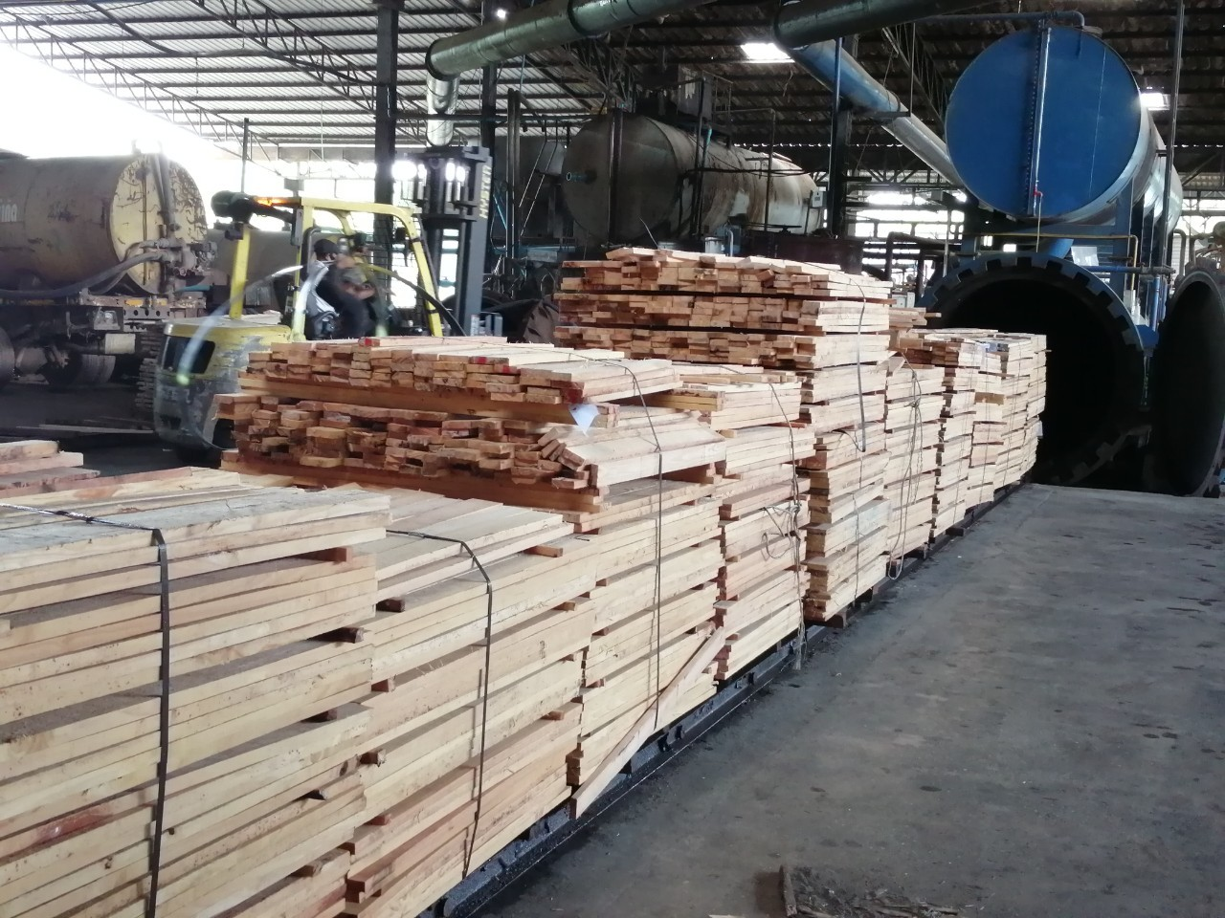
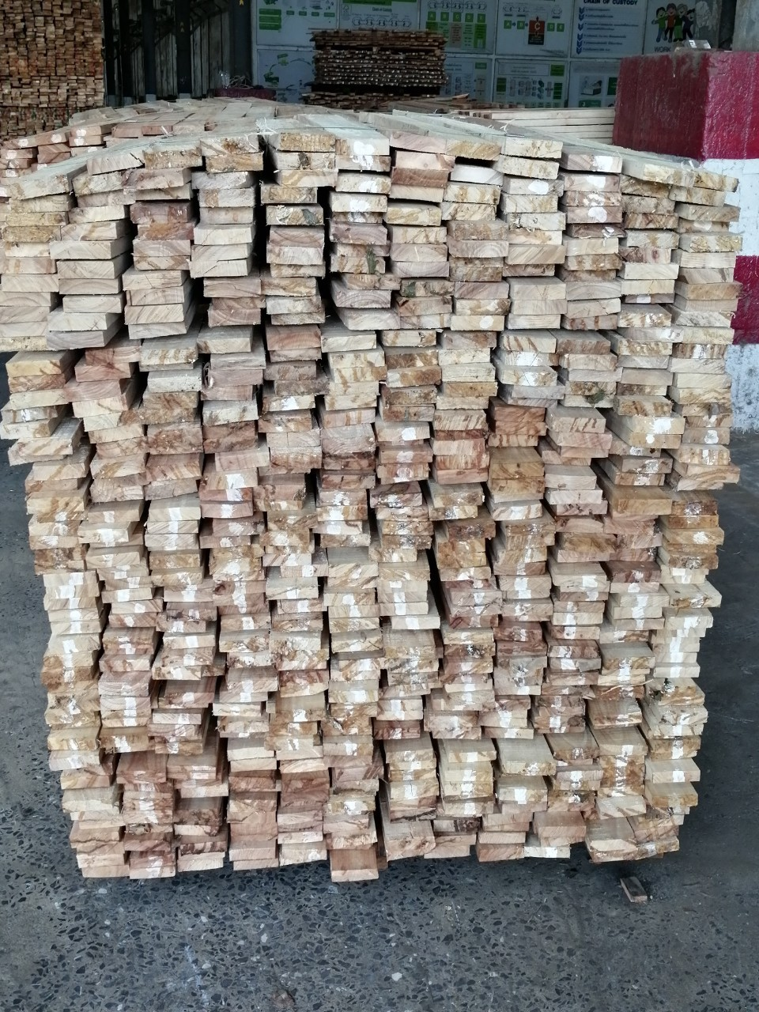
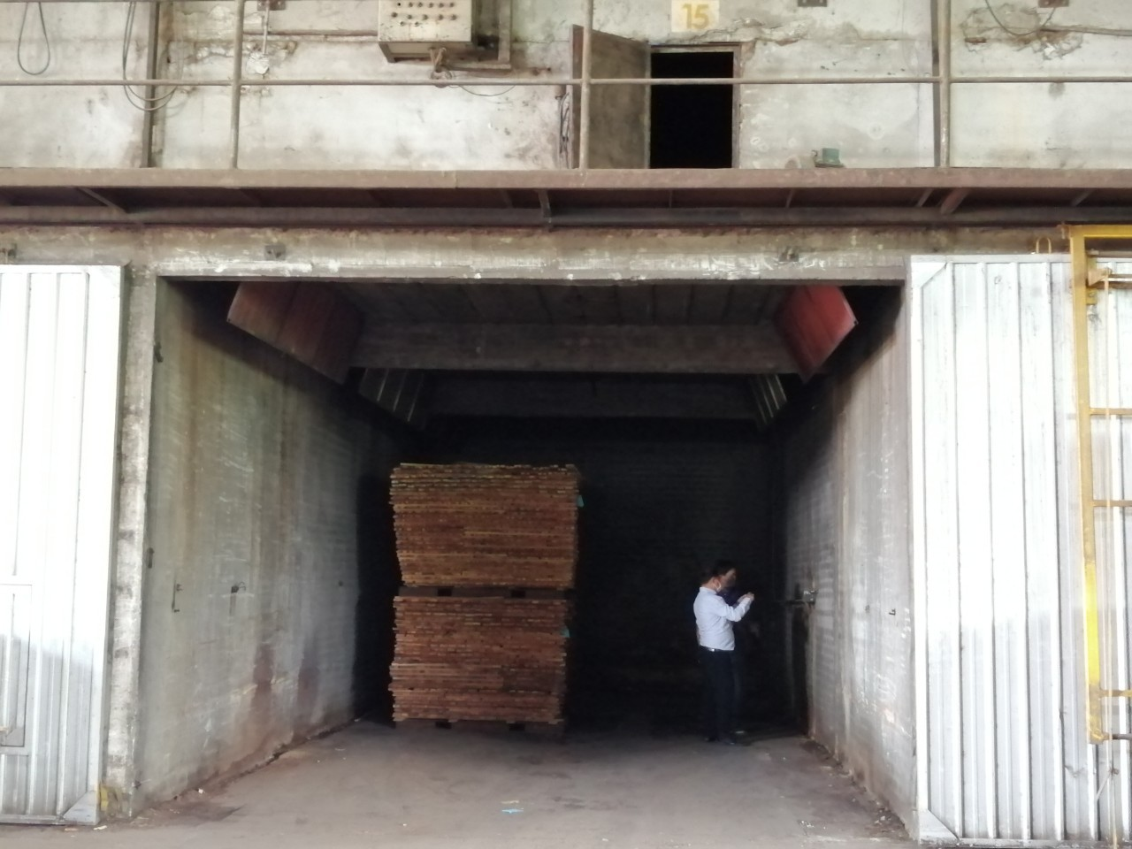
A Success Case

Slide 22
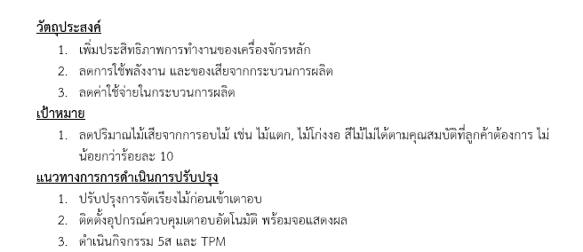
> 10 % Defect Reduction

Slide 23
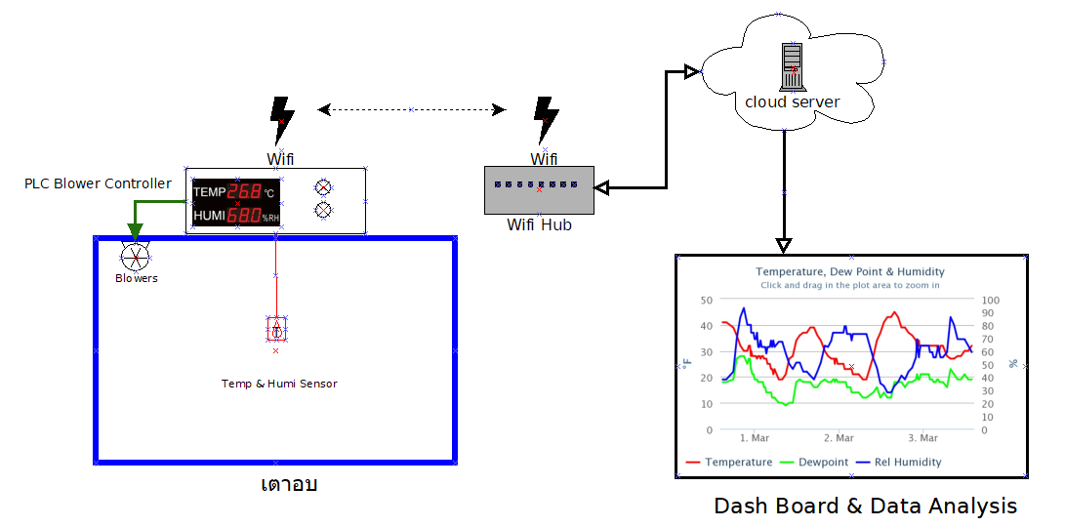
I.O.T in Actions

Slide 24
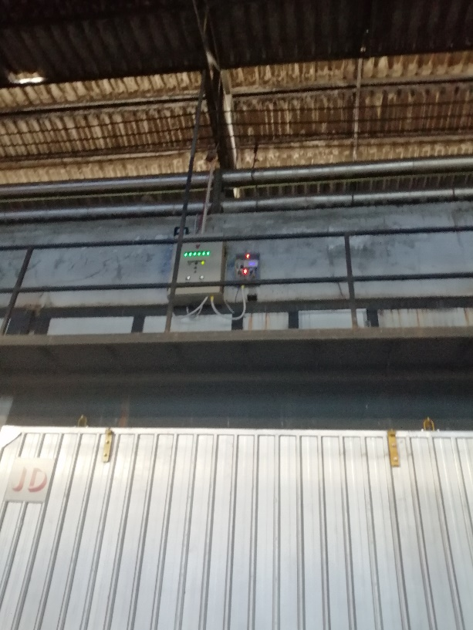
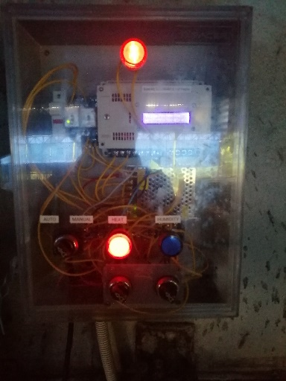

Slide 25
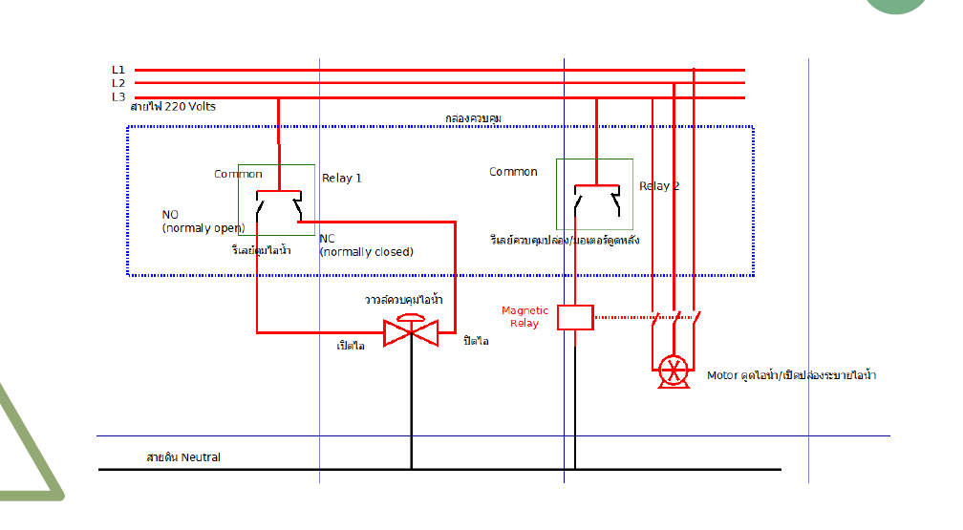

Slide 26
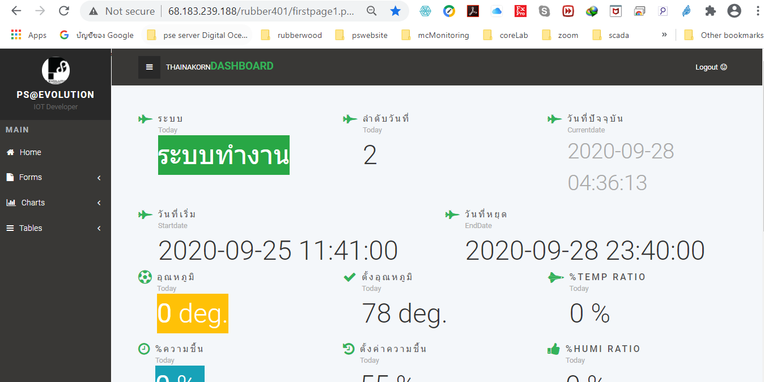

Slide 27
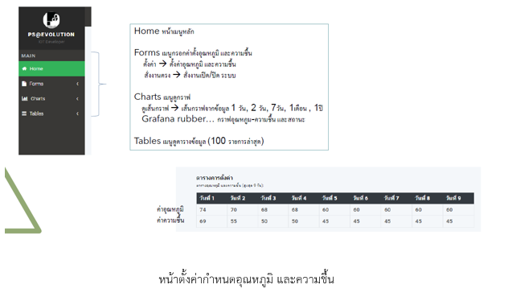

Slide 28
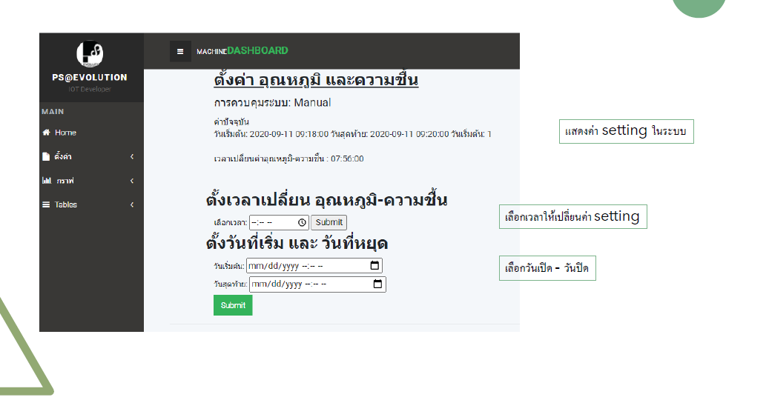

Slide 29
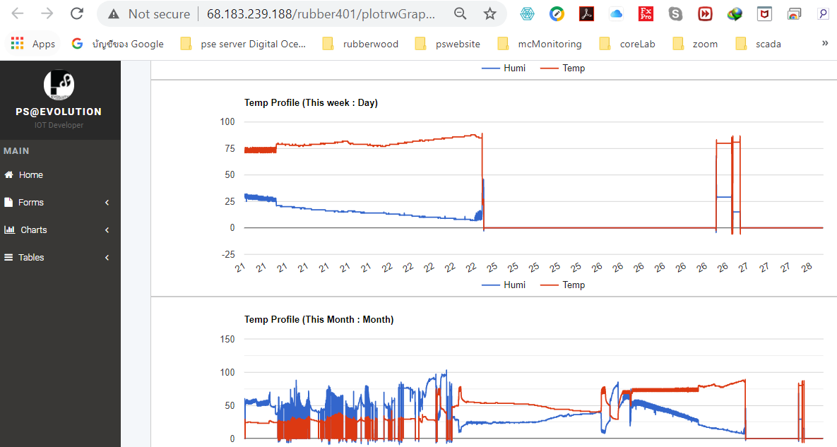

Slide 30
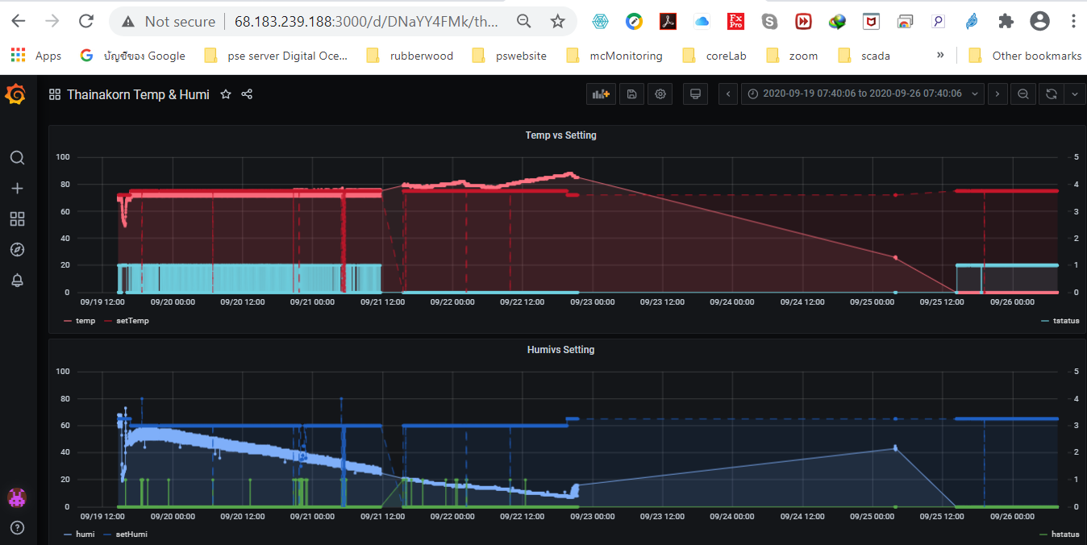

Slide 31
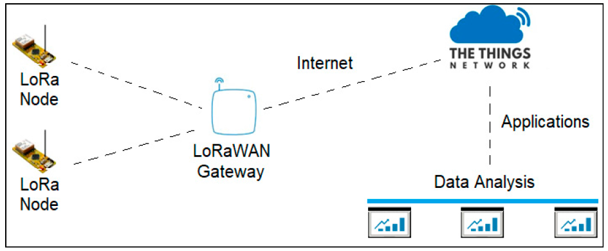
A new Way to Go - Lorawan

Slide 32
Cloud IOT Server Services
Network Server
GATEWAY
GATEWAY
API
GATEWAY
Surveillance
Sensors
Temp/Humidity
Sensors
PM2.5 Sensors
SYSTEM OVERVIEW of LORAWAN

Slide 33
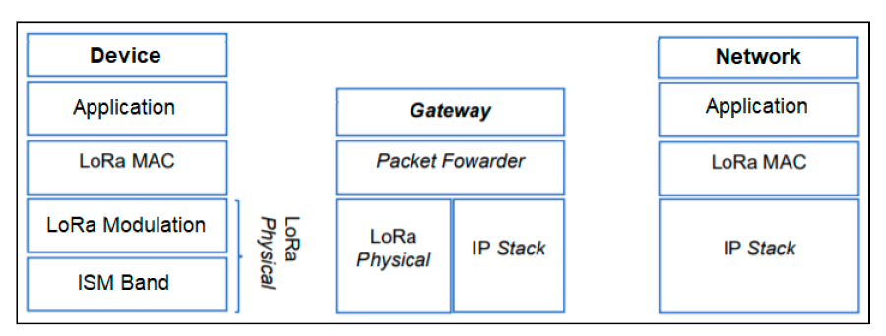
System architecture
สถาปัตยกรรมของระบบ LORA WAN

Slide 34
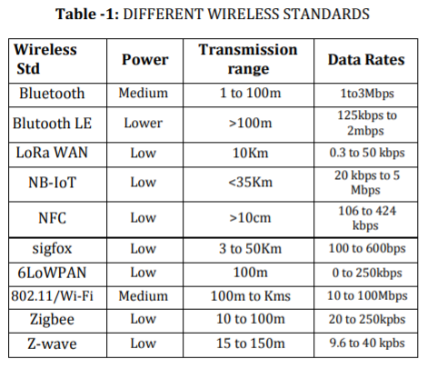
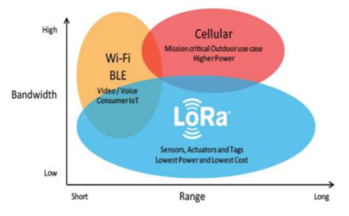
Integrated services
มาตรฐานการส่งคลื่นแบบสาย
กราฟเปรียบเทียบการใช้คลื่นความถี่ของระบบไร้สายในปัจจุบัน

Slide 35
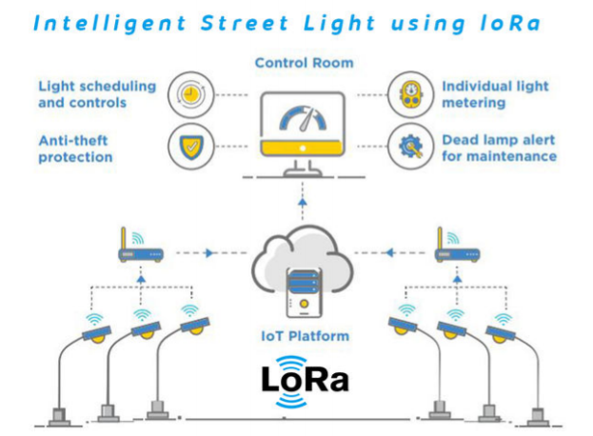
ตัวอย่างการใช้งานของระบบ

Slide 36
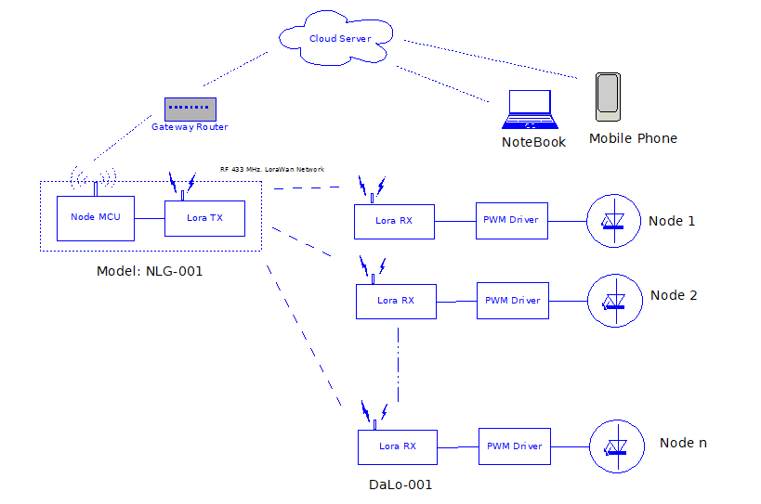

Slide 37
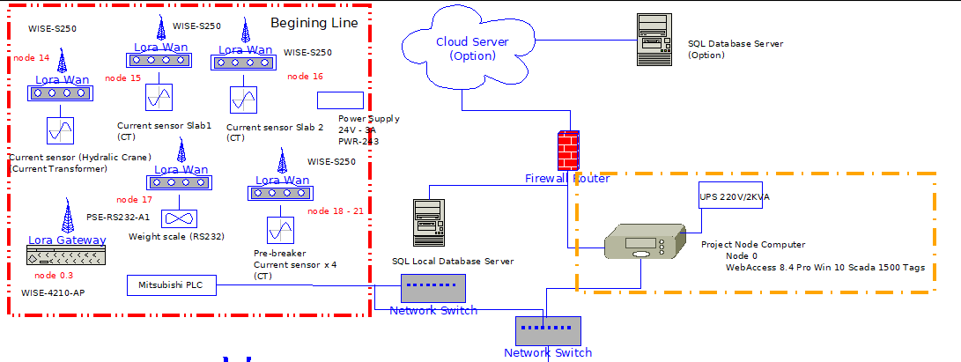

Slide 38
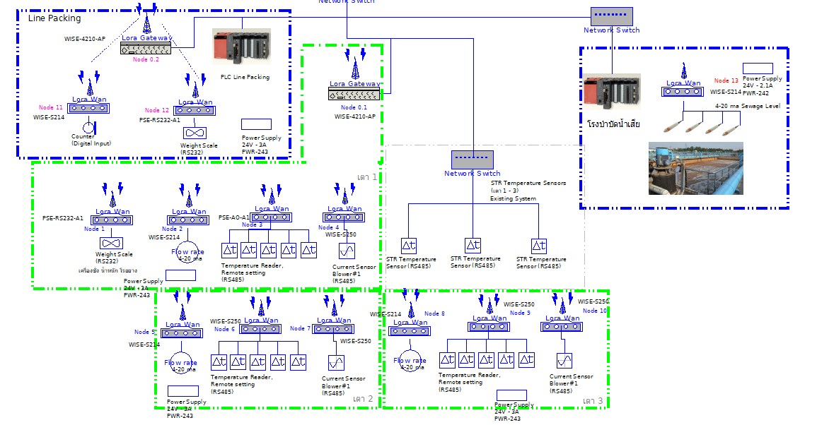

Slide 39
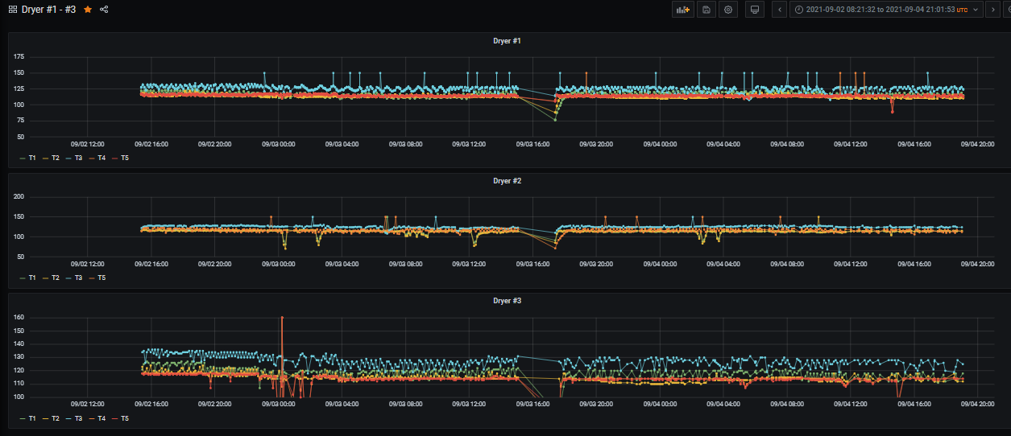

Slide 40
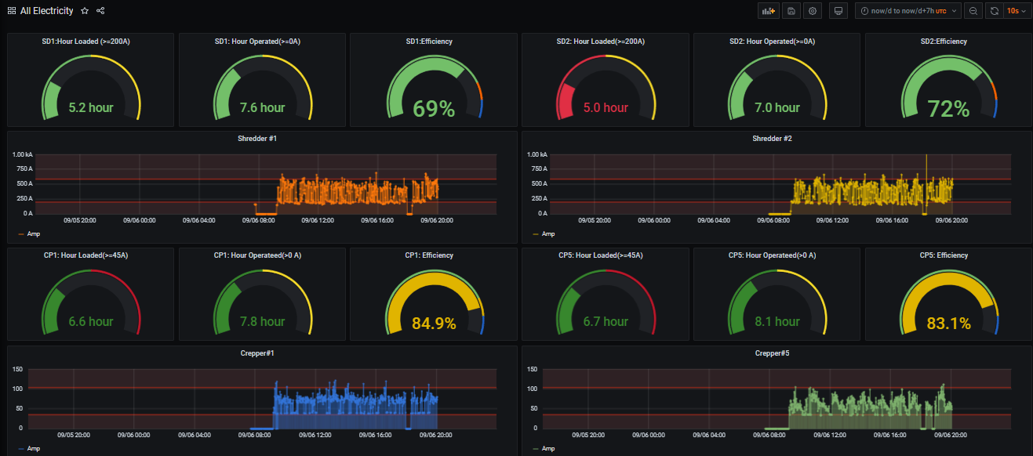

Slide 41
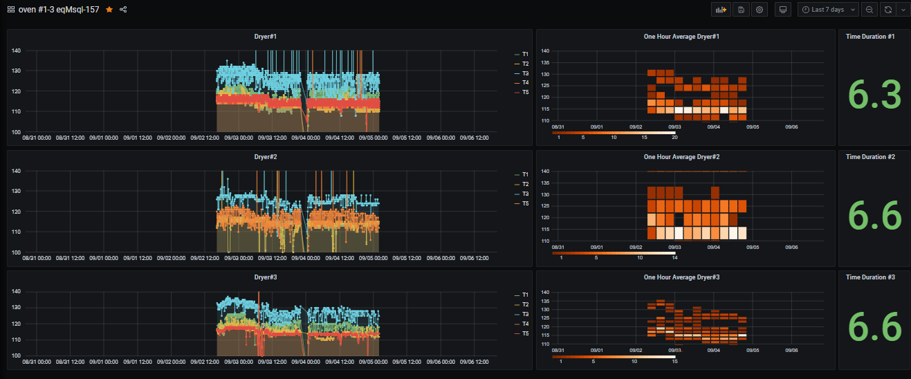

Slide 42
End of Session 1

